Slide 1
Navigating the Treacherous Waters of Form I-9
Winter 2022

Slide 2
INTRODUCTIONS
John W. Mazzeo, Associate General Counsel – Director of I-9 and E-Verify Compliance
John Mazzeo is Truescreen’s new Associate General Counsel and Director of I-9 and E-Verify compliance. Previously, John served as an Assistant Chief Counsel with Immigration and Customs Enforcement, a component of the Department of Homeland Security where he served as the legal counsel for all worksite enforcement and Form I-9 investigations and sanctions in Pennsylvania, Delaware, and West Virginia. During his tenure with DHS-ICE, John conducted regular meetings with Homeland Security Investigations Auditors and Special Agents concerning changes in the law and points of concern. In his role at Truescreen, John focuses on supporting our I-9 and E-Verify operations division regarding compliance and best practices. John is available to all of our clients as a subject matter expert on issues involving I-9 and E-Verify. John holds a Juris Doctor from the Drexel University Thomas R. Kline School of Law, and an undergraduate degree from Ursinus College. Like Alex, John is also a member of the Association of Corporate Counsel.
N. Alexander Erlam, General Counsel
Alex Erlam is Truescreen’s general counsel and employment law specialist. Alex has over 25 years of experience in all areas of employment law, and has developed expertise in background screening law, including the FCRA, the Gramm-Leach-Bliley Act, and the Drivers Protection Act, discrimination law, and immigration law, as well as general human resources expertise. Alex recently served on the Association of Corporate Counsel Board of Directors and is a past president of its Greater Philadelphia chapter. In his role at Truescreen, Alex directs the company’s legal affairs and is responsible for maintaining compliance with all applicable laws and regulations. He serves as our expert resource to clients on legal and regulatory developments and case law. Alex has a law degree from the Temple University James E. Beasley School of Law and a bachelor’s degree in political science/pre-law from Villanova University.

Slide 3
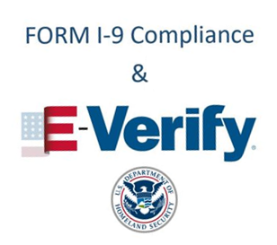
AGENDA
Session I – Overview of Form I-9
Session II – Advanced Form I-9 Issues
Session III – Handling the Form I-9 Audit
Session IV – Overview of the E-Verify Program
This webinar is designed solely for informational purposes, and should not be inferred or understood as legal advice or binding case law, nor shared with any third parties. Persons in need of legal assistance should seek the advice of competent legal counsel.

Slide 4
TODAY’S AGENDA
Overview of the audit and enforcement process;
Types of Form I-9 violations;
Possible dispositions of ICE audits; and
How to be prepared for when ICE knocks on your door

Slide 5
REGULATORY AGENCIES INVOLVED
United States Citizenship and Immigration Services (USCIS) – Publishes and updates the Form I-9; Responsible for administering the E-Verify Program
Social Security Administration (SSA) – Partner in E-Verify Program
Immigration and Customs Enforcement (ICE) – Component of DHS charged with investigating and issuing fines for violations of Form I-9
Department of Justice (DoJ) - OCAHO; IER
Department of Labor (DoL) – Authority to subpoena Forms I-9 in their own enforcement actions under wage/hour laws
Notes:
Special Agents – Investigate
Auditors – review each Form I-9; compare it to the employee list
Office of Principal Legal Advisor – ICE attorneys who review the investigation, negotiate settlements or litigate the case to completion
ECIC – Employer Compliance Inspection Center – Division of Homeland Security Investigations responsible for completing nationwide audits

Slide 6
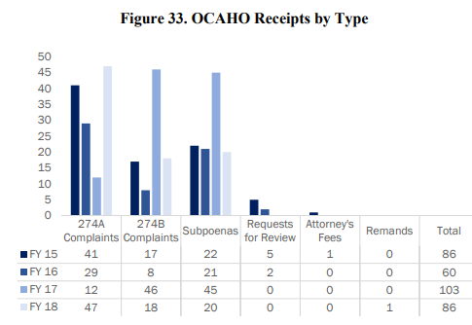
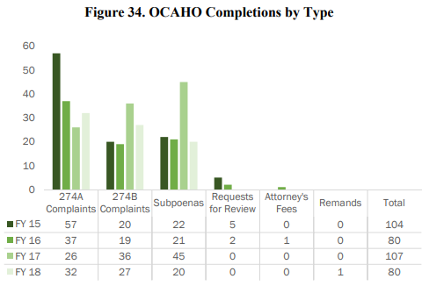
AUDIT STATISTICS
Create a culture of compliance though criminal arrests of employers, administrative arrests of employees, compliance of the I-9 Employment Eligibility Verification Form, and the IMAGE program
FY 2020 (October 2019-September 30, 2020)
4,326 new investigations; 3,903 Form I-9 inspections
Notes:
https://www.dhs.gov/sites/default/files/publications/u.s._immigration_and_customs_enforcement.pdf
https://www.justice.gov/eoir/file/1198896/download

Slide 7
THE ICE AUDIT PROCESS
Notice of Inspection
Initiates the Process; demand for production of documents
Normally three days to respond
Best practice: Inform your immigration counsel ASAP and have them coordinate all document production with ICE
Inspection/Audit
Auditor will conduct an investigation and review Forms I-9
Notice of Suspect Documents
ICE determines that the documents provided by the employee do not relate to the employee or are not valid for employment
Notice of Discrepancies
Issued when ICE cannot determine an employee’s eligibility to work
Notes:
Notice of Inspection
Normally hand-delivered by ICE Special Agent and Auditor
Can also be sent via mail
Demands a list of documents and Forms I-9 required to be presented within three business days, unless an extension is granted in writing.
The Inspection
Conducted either at the worksite or at a DHS office
Auditor reviews all of the documents, determines whether any employees lacked work authorization, determines which, if any, employees were missing Forms I-9, determines if any of the seized Forms I-9 have errors.
Notice of Technical or Procedural Failures
The Form I-9 is divided into “Technical or Procedural Violations” and “Substantive Paperwork Violations”
Substantive violations cannot be cured
Employers are given 10 days by statute to correct technical or procedural violations
10 days is triggered by the Notice of Technical or Procedural Violations
If not corrected, can be subject to civil fine
Notice of Discrepancies
When ICE thinks an employee lacks work authorization, but cannot prove it.
Advises the employer that based on a review of the Forms I-9 and documentation submitted by the employee, ICE has been unable to determine their work eligibility.
The employer should provide the employee with a copy of the notice, and give the employee an opportunity to present ICE with additional documentation to establish their employment eligibility.
Notice of Suspect Documents
When ICE believes, based on database checks, that an employee or employee submitted fraudulent documents
Advises the employer that based on a review of the Forms I-9 and documentation submitted by the employee, ICE has determined that an employee is unauthorized to work and advises the employer of the possible criminal and civil penalties for continuing to employ that individual. ICE provides the employer and employee an opportunity to present additional documentation to demonstrate work authorization if they believe the finding is in error.

Slide 8
THE ICE AUDIT PROCESS
Were violations found during the audit?
If substantive violations, then either a warning notice or Notice of Intent to Fine
If technical violations, then Notice of Technical or Procedural Violations may be issued, giving the company 10 days to make corrections to avoid a fine
Can ICE bring a Criminal Charge?

Slide 9
POSSIBLE DISPOSITIONS
Notice of Inspection Results
A “compliance” letter; no deficiencies found
Warning Notice
Deficiencies were found, but ICE has chosen not to prosecute the case
Notice of Intent to Fine
Lists the violations and penalty amount.
Reviewed by an ICE attorney before being served on company
Business has 30 days to either negotiate a settlement or request a hearing
If no action by day 30, it becomes a final, unappealable order
Notes:
Notice of Inspection Results - also known as a "compliance letter," used to notify a business that they were found to be in compliance.
Warning notice - issued in circumstances where substantive verification violations were identified, but circumstances do not warrant a monetary penalty and there is the expectation of future compliance by the employer.
Notice of Intent to Fine
May be issued for substantive, uncorrected technical, knowingly hire and continuing to employ violations.
30 days to pay the fine amount, negotiate a settlement or request a hearing with the Office of Chief Administrative Hearing Officer
If the employer does not respond within 30 days it becomes a final, unappealable order

Slide 10
TYPES OF VIOLATIONS
Substantive Violations
“Paperwork Violations”
Failure to Prepare
Technical/Procedural Violations that were not remedied
Technical/Procedural Violations
Knowing Hire
Continuing to Employ

Slide 11
SUBSTANTIVE/PAPERWORK VIOLATIONS
In Section 1, failure to ensure:
Employee provides name;
Employee selects attestation;
Employee provides alien, USCIS, or admission number (if required);
Employee signature and date;
Ensure completion by the end of the first day of employment
In Section 2, failure to:
Review and verify proper documents;
Record required information from the documents except if a photocopy is retained and presented;
Sign and date the attestation;
Complete Section 2 by the end of the third business day of employment

Slide 12
SUBSTANTIVE/PAPERWORK VIOLATIONS, cont.
In Section 3, failure to:
Review and verify proper documents;
Record required information from the documents except if a photocopy is retained and presented;
Sign and date the attestation;
Complete Section 3 by the date work authorization expires

Slide 13
SUBSTANTIVE VIOLATIONS – FAILURE TO PREPARE OR PRESENT
During the audit, the auditor will use public records – tax filings, unemployment filings – along with the requested employee roster and determine a list of individuals who were within the retention period
The auditor will then sort through each Form I-9 to determine whether a Form I-9 was completed for each required individual
If the Form I-9 is not available, then it is a violation
Also applies to Forms I-9 “found” or turned over after the date mandated in the NOI

Slide 14
TECHNICAL/PROCEDURAL VIOLATIONS
In Section 1, failure to ensure:
Employee provides maiden name, address, or birth date;
Employee provides alien, USCIS, or admission number if a photocopy is retained or it is recorded in Section 2;
Employee dates Section 1 at the time of hire;
Ensure that preparer or translator provides name, address, signature, and date
In Section 2, failure to:
Record required document information if a legible copy is provided;
Provide title, business name, and business address;
Provide date of hire;
Date Section 2
In Section 3, failure to:
Provide required document information if a legible copy is provided;
Provide date of hire in Section 3

Slide 15
KNOWING HIRE/CONTINUING TO EMPLOY VIOLATIONS
8 U.S.C. § 1324a(a)(1) – unlawful “to hire … an alien knowing the alien is an unauthorized alien”
8 U.S.C. § 1324a(a)(2) – unlawful “to continue to employ [an] alien knowing the alien is (or has become) an unauthorized alien
8 U.S.C. § 1324a(h)(3) – unauthorized alien defined as an individual who is neither a lawful permanent resident nor authorized to work
Knowledge may be direct or circumstantial

Slide 16
POSSIBLE FINES AND PENALTIES
All fines are determined based on the failure percentage
Number of deficient or missing Forms I-9 divided by number of total expected Forms I-9
Base fine amount ranges from $252-$2,507 for substantive violations
Base fine amount ranges from $627-$2,507 per violation for knowing hire/continuing to employ
Once the base fine is calculated, it is either enhanced or mitigated based on five statutory elements
Debarment
Notes:
The goal of fines – as told by OCAHO case law – is compliance/deterrence; not punishment.
ICE fine ranges not binding on OCAHO judges.

Slide 17
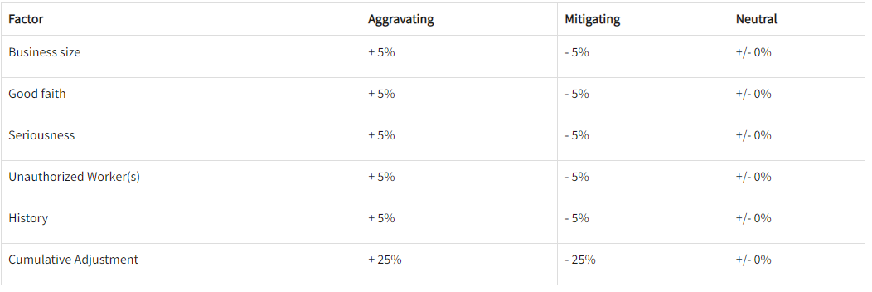
POSSIBLE FINES AND PENALTIES
Notes:
Unauthorized workers is a high bar; case law holds that DHS must present actual evidence that they lacked work authorization, not just a no-match. This requires taking fingerprints/encountering the employee most times, unless DHS can show lack of status some other way, such as through immigration applications.

Slide 18
SETTLEMENT PROCESS
Notice of Intent to Fine is issued; 30 day clock begins
ICE attorney has limited authority to settle without seeking approval
Can normally only accept a settlement of 90% or more without approval
Very few cases are settled within 30 days, so the company must request a hearing
At any time after request for hearing, ICE can file a complaint, however most ICE attorneys seek to settle cases and only file when absolutely necessary

Slide 19
SETTLEMENT PROCESS, cont.
Only negotiating the settlement amount; most, if not all, of the provisions in the standard ICE agreement are non-negotiable
However, sometimes the company is able to agree to a payment plan
Once the parties agree to a settlement amount, ICE attorney will draft the agreement for signature by all parties
Once executed, the agreement, plus the Notice of Intent to Fine is served on the company and a copy sent to the ICE finance center
The ICE finance center will issue a bill (or bills, if part of a settlement agreement) with payment instructions

Slide 20
LITIGATION
ICE must file the complaint with the Office of Chief Administrative Hearing Officer by the time the statute of limitation expires
Failure to prepare or present – 5 years from service of the NOI;
Failure to timely prepare/complete – 5 years from required completion date;
Other “paperwork” violations – 5 years from service of the NOI
Company has 30 days to respond
Your lawyer will file the response along with a Form E-28, Notice of Appearance
The judge will set deadlines based on case complexity

Slide 21
LITIGATION, cont.
Most cases are disposed of on Motion for Summary Decision because no facts are in dispute; only the penalty amount
Many judges will issue a decision on liability and then require additional briefing on penalty
Some cases require a hearing
Particularly those involving intent or knowledge
Knowing Hire/Continuing to Employ

Slide 22
LITIGATION – POST DECISION
Judge’s decision can be challenged:
Appeal to the Attorney General
Must be filed within 10 days of entry of decision
Appeal to circuit court
Must be filed within 45 days of the “final” decision
Once order is “final,” ICE serves the order on the company and sends the case to ICE financial center for processing and billing

Slide 23
RECENT CASES (SUBSTANTIVE VIOLATIONS)
U.S. v. Psychosomatic Fitness, LLC. (May 27, 2021) $136,400.00
2 Count NIF alleging:
88 Failures to Prepare/Present Form I-9;
22 failures to ensure proper completion of and/or properly complete Form I-9.
Administrative Law Judge reduced fine from $1,901 per violation to $1,300 per violation for Failure to Prepare/Present and $1,000 per violation for failure to ensure proper completion.
Fine was issued even though company sought a decrease in the fine due to COVID-19 closures.
U.S. v. 1523 Avenue J Foods, Inc., (June 9, 2020) $28,043.00
2 Count NIF alleging:
28 Failures to Prepare/Present Form I-9;
1 failure to ensure proper completion of and/or properly complete Form I-9.
Administrative Law Judge reduced fine from $1,862 per violation to $967 per violation
Notes:
U.S. v. Psychosomatic Fitness, LLC., 14 OCAHO no. 1387 (2021)
U.S. v. Eriksmoen Cottages, Ltd., 14 OCAHO no. 1355 (2020)
U.S. v. 1523 Avenue J Foods, Inc., 14 OCAHO no. 1361 (2020) – ALJ found liability even though they claimed impossibility – that the documents were ruined in a flood.

Slide 24
ASPLUNDH TREE EXPERTS, CO.
Largest worksite enforcement fine in history
6 year investigation; started with an administrative Form I-9 audit
$80,000,000 criminal forfeiture; $15,000,000 civil administrative penalty
Company pleaded guilty to knowingly hiring unauthorized aliens
Admitted to being “willfully blind” to the hiring practices of supervisors and foremen in the field
Supervisors and foremen were also criminally charged
Notes:
Asplundh Tree Experts, Co. pays largest civil settlement agreement ever levied by ICE | ICE

Slide 25
CASE STUDY – R&SL, INC.
9/7/16 – Notice of Inspection (documents due to ICE by 9/16/16);
9/20/16 – ICE confirms receipt of “three large boxes” of Forms I-9;
5/12/17 – Notice of Procedural or Technical Failures issued;
7/13/18 – Notice of Intent to Fine issued;
7/30/18 – R&SL Requested a hearing;
8/7/19 – ICE files Complaint;
11/25/20 – Decision on Motion for Summary Decision;
6/15 and 6/17/21 – Hearing;
1/6/2022 – Final Decision and Order.
Notes:
13 OCAHO no. 1333a
13 OCAHO no. 1333b

Slide 26
CASE STUDY – R&SL, INC.
NIF:
Count I: Continuing to employ unauthorized alien;
Count II: Failed to prepare/present 518 Forms I-9;
Count III: Failure to timely prepare 276 Forms I-9;
Count IV: Failure to ensure proper completion/properly complete 1,192 Forms I-9.
Decision on Motion for Summary Decision:
Count I: sole violation dismissed;
Count II: 5 violations dismissed; 512 held for trial;
Count III: 63 violations dismissed; R&SL found liable for 213 violations;
Count IV: R&SL found liable for 1,015 violations; 177 held for trial.

Slide 27
CASE STUDY – R&SL, INC.
Final Decision and Order:
Count II: ICE did not prove that R&SL did not prepare 511 Forms I-9; 511 violations dismissed.
Count IV: R&SL found liable for 177 violations.
R&SL ordered to pay $1,527,308.90
ICE originally sought more than $3,000,000
R&SL paid more than $102,000 in legal fees to secure a hearing.
R&SL paid upwards of $1,000,000 in litigating the case prior to the hearing in June, 2021.

Slide 28
CASE STUDY – R&SL, INC.
Takeaways:
Perils of having a decentralized storage system; R&SL had to retrieve documents from multiple locations;
Importance of candor; ALJ refused to mitigate the penalty amount as it related to the 177 backdated Forms I-9;
Timely requesting a hearing and ensuring that request is received;
Significance of internal audits and training;
Ensuring that all of your processes and actions during a Form I-9 audit (from the time you receive the NOI) are documented.

Slide 29
CASE STUDY (KNOWING HIRE/CONTINUE TO EMPLOY)
United States v. Jalisco’s Bar and Grill, Inc.
ICE’s proof consisted of Reports of Investigation detailing interviews conducted by HSI agents of two employees who admitted to being unauthorized and having told the owner prior to being hired
United States v. Muniz Concrete & Contracting, Inc.
ICE’s proof consisted of Forms I-9 for two individuals who had finite work authorization, were not reverified using Section 3, and continued to be employed (as evinced by wage tax documents obtained by ICE)
Notes:
11 OCAHO no. 1224 (2014)
12 OCAHO no. 1278 (2016)

Slide 30
WHAT TO DO WHEN ICE KNOCKS ON YOUR DOOR
Contact your immigration counsel immediately to coordinate document production and represent you before ICE;
Do not speak to the ICE Agents (outside of being cordial and respectful);
Anything that you say can and will be used against you
Do not waive the three-day period;
Do not let ICE Agents speak with anyone on your property without first contacting your attorney;
Make a copy of each document you are turning over to ICE.

Slide 31
HOW TO PREPARE FOR AN AUDIT
Have a plan in place;
ICE requests certain documents with each audit, so have those documents already prepared and ready to go;
Invest in training your HR staff;
Complete an annual internal audit;
Employ a tickler system to ensure timely reverification and timely purging of Forms I-9 no longer subject to retention requirements.
Notes:
Have a plan in place
Do you have an attorney on retainer? If not, do you know who you will call?
ICE requests certain documents with each audit, so have them prepared ahead of time, it will save you time and stress. Some documents usually requested are:
Wage and payroll records;
Incorporation documents;
Tax documents;
All Forms I-9 and supporting documents;
Employee list;
State and Federal Quarterly Wage Tax Reports;
Business EIN, proprietor’s social security number;
Proof of enrollment in E-Verify;
All correspondence regarding E-Verify no-match letters.

Slide 32
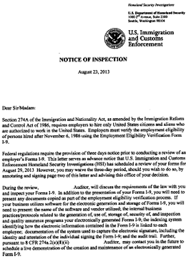
DOCUMENTS REQUESTED BY NOTICE OF INSPECTION
All Forms I-9 within the retention period;
Employee roster with hire dates;
Quarterly taxes for the last five years;
Business information:
Articles of incorporation;
EIN;
Certificate of incorporation;
Any E-Verify documentation, such as the MOU;
Documents as seen fit by the Auditor/Special Agent

Slide 33
COMPLETING AN INTERNAL AUDIT
Catch and correct errors;
Use knowledge obtained from internal audit to correct bad habits;
Systematically go through Forms I-9 using the checklists provided in the Virtue Memorandum;
Must make sure it is not discriminatory; if you are doing a sampling you must make sure that you aren’t capturing only Forms I-9 showing a certain citizenship category;
USCIS recommends that employers notify employees in writing of an internal audit

Slide 34
FUTURE OF ICE AUDITS
Focus on backlog of Form I-9 investigations;
Improve efficiencies by sending NOI via certified mail;
Advanced training at the Federal Law Enforcement Training Center;
Automate Form I-9 audits using Compliance Automation Tool;
Centralize ICE audits at HSI HQ, take them away from the field

Slide 35
HOW CAN TRUESCREEN HELP YOU?
Digitizing and indexing of historical Forms I-9;
Auditing and remediation services;
Remote completion of Section 2 of Form I-9;
I-9 Management tool that allows a user to monitor the status of Form I-9
Completion status, hire date, etc. – completely customizable
Customizable reverification alerts

Slide 36
QUESTIONS?
ALEX ERLAM | JOHN MAZZEO
aerlam@truescreen.com jmazzeo@truescreen.com

