Slide 1
Navigating the Treacherous Waters of Form I-9
Winter 2021

Slide 2
INTRODUCTIONS
N. Alexander Erlam, General Counsel
Alex Erlam is Truescreen’s general counsel and employment law specialist. Alex has over 25 years of experience in all areas of employment law, and has developed expertise in background screening law, including the FCRA, the Gramm-Leach-Bliley Act, and the Drivers Protection Act, discrimination law, and immigration law, as well as general human resources expertise. Alex recently served on the Association of Corporate Counsel Board of Directors and is a past president of its Greater Philadelphia chapter. In his role at Truescreen, Alex directs the company’s legal affairs and is responsible for maintaining compliance with all applicable laws and regulations. He serves as our expert resource to clients on legal and regulatory developments and case law. Alex has a law degree from the Temple University James E. Beasley School of Law and a bachelor’s degree in political science/pre-law from Villanova University.
John W. Mazzeo, Associate General Counsel – Director of I-9 and E-Verify Compliance
John Mazzeo is Truescreen’s new Associate General Counsel and Director of I-9 and E-Verify compliance. Previously, John served as an Assistant Chief Counsel with Immigration and Customs Enforcement, a component of the Department of Homeland Security where he served as the legal counsel for all worksite enforcement and Form I-9 investigations and sanctions in Pennsylvania, Delaware, and West Virginia. During his tenure with DHS-ICE, John conducted regular meetings with Homeland Security Investigations Auditors and Special Agents concerning changes in the law and points of concern. In his role at Truescreen, John focuses on supporting our I-9 and E-Verify operations division regarding compliance and best practices. John is available to all of our clients as a subject matter expert on issues involving I-9 and E-Verify. John holds a Juris Doctor from the Drexel University Thomas R. Kline School of Law, and an undergraduate degree from Ursinus College. Like Alex, John is also a member of the Association of Corporate Counsel.

Slide 3
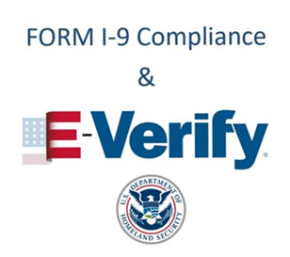
AGENDA
Session I – Overview of Form I-9
Session II – Advanced Form I-9 Issues
Session III – Handling the Form I-9 Audit
Session IV – Overview of the E-Verify Program
This webinar is designed solely for informational purposes, and should not be inferred or understood as legal advice or binding case law, nor shared with any third parties. Persons in need of legal assistance should seek the advice of competent legal counsel.

Slide 4

TODAY’S AGENDA
How to document a rehire
When and how to document an extension of work authorization
When and how to complete a reverification in Section 3 of Form I-9
How to correctly document the employment eligibility of an H-1B employee
Rules for self-auditing and correcting Forms I-9

Slide 5
REHIRES
When is it a rehire?
  When there was a break in employment with no expectation of return
Examples of continuing employment:
  Approved paid or unpaid leave
  Promotions, demotions, or pay raises
  Temporary layoff due to lack of work
  Strikes or labor disputes
  Reinstatement after disciplinary suspension for wrongful termination found unjustified by an adjudicator
  Transfer from one distinct unit of an employer to another
  Seasonal employment
  Continued employment with a related, successor, or reorganized employer
Notes:
8 C.F.R. 274a.2(b)(1)(viii);
8 C.F.R. 274a.2(b)(1)(viii)(A)(1)-(8)

Slide 6
REHIRES
Factors to consider when determining if the employee is “rehired:”
  Was the individual employed on a “regular and substantial basis” when compared to other employees;
  Whether the employee complied with an established and published policy regarding the absence;
  Whether the employer’s past history of recalling absent employees indicates the likelihood that the individual in question will resume employment with the employer within a reasonable time;
  Whether another worker has not permanently taken the individual’s former position;
  Did the employee avail themselves of any benefits inconsistent with an expectation of continued employment?
  Whether the employer’s financial condition allows the individual to resume employment within a reasonable time; and
  The oral and/or written communication between employer and employee indicates the employee will likely resume employment within a reasonable time.
Notes:
8 C.F.R. 274a.2(b)(1)(viii)(B)(1)-(7)

Slide 7

DOCUMENTING A REHIRE
You also have the option of completing a new Form I-9 for the employee, but if you do so you must complete the entire form.
You may simply complete Section 3 if certain conditions are met.
If the Form I-9 used for the initial verification is not the current version of the Form I-9, you can complete a Section 3 on the current version of the Form I-9.

Slide 8
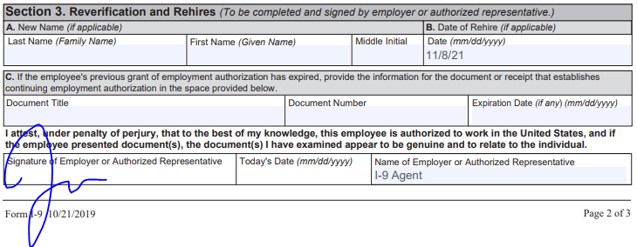
DOCUMENTING A REHIRE
Original Form I-9 is the current version of the Form I-9 and no reverification needed:
11/8/21

Slide 9
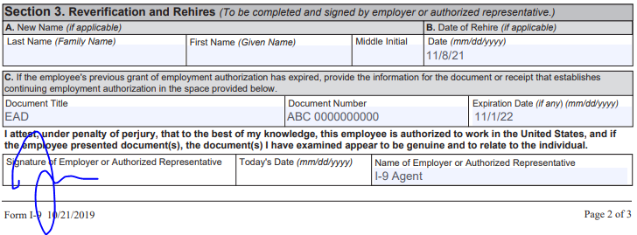
DOCUMENTING A REHIRE
Original Form I-9 is the current version of the Form I-9 and reverification needed:
11/8/21

Slide 10
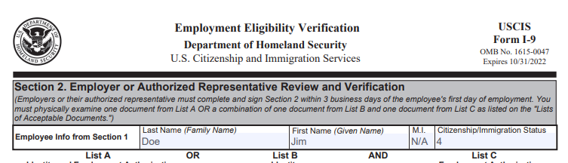

DOCUMENTING A REHIRE
Original Form I-9 is not the current version and no reverification needed:
11/8/21

Slide 11
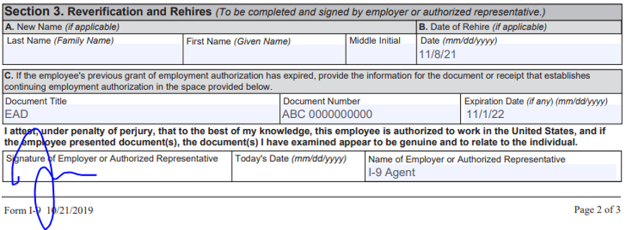
DOCUMENTING A REHIRE
Original Form I-9 is not the current version and reverification needed:
11/8/21

Slide 12
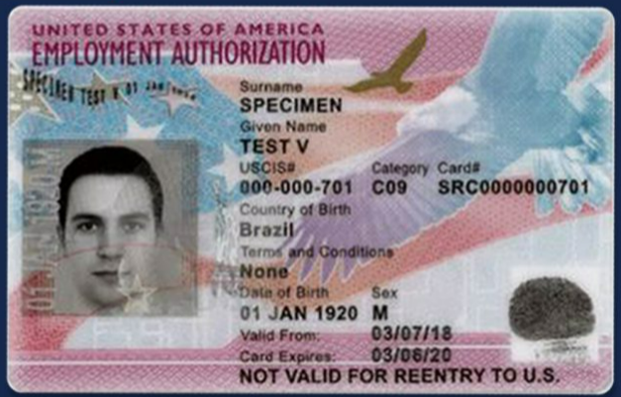
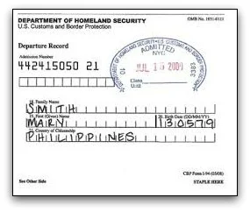
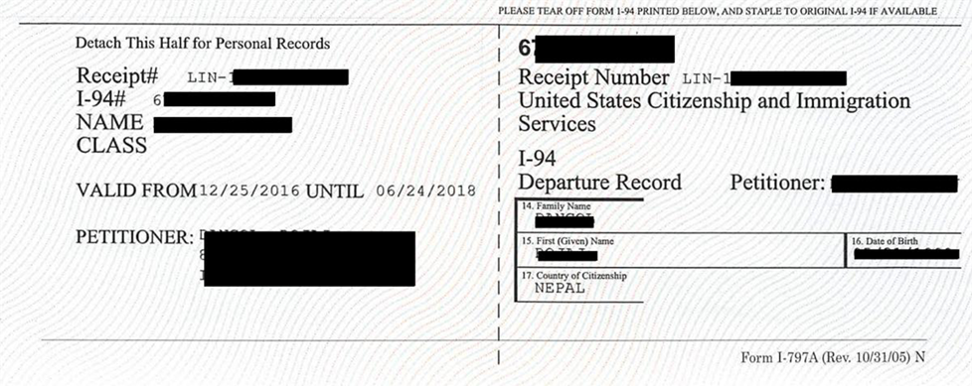
IMPORTANT I-9 DOCUMENTS
Notes:
We are going to discuss a lot of documents today, but three are very important…

Slide 13
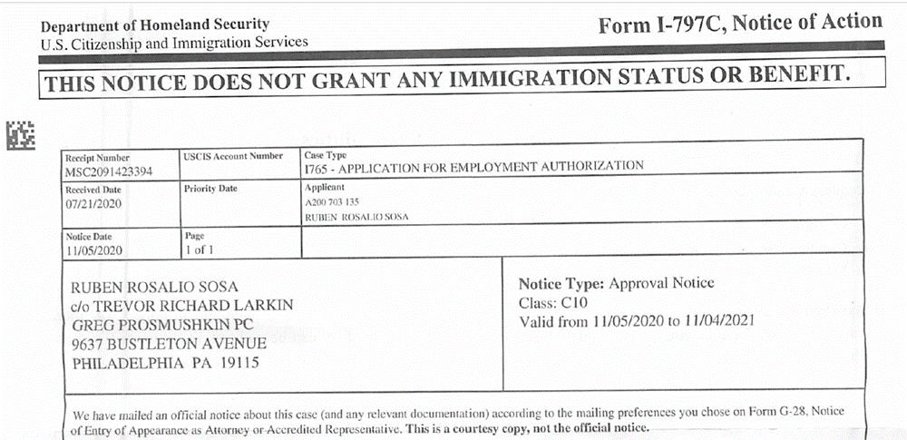
IMPORTANT I-9 DOCUMENTS
Notes:
For a compendium of documents issued by USCIS and related agencies, visit: SAVEGuideCommonlyusedImmigrationDocs.pdf (uscis.gov)

Slide 14

EXTENSIONS V. REVERIFICATIONS
Employers must ensure that their employees are authorized to work throughout the tenure of their employment.
Many employers use a tickler system or have a tool that alerts human resources when an employee needs to be reverified.
There are times when employees qualify for an extension of their EAD.
Reverifications are completed in Section 3 of Form I-9 while extensions are documented using the additional information field in Section 2 of Form I-9.
Both require the employer or agent to verify that the employee remains work authorized and collect photocopies of documents, if applicable.
Employees must reverify at the end of their extension period.
Notes:
8 C.F.R. 274a.2(b)(1)(viii).
Or as we in the industry like to say, Section 3 or no Section 3, that is the question.

Slide 15
REVERIFICATION
Some employees may have only temporary work authorization and thus require reverification:
  Employment Authorization Document Form I-766 (EAD);
  Form I-94 with a temporary Form I-551 stamp or MRIV;
  Form I-94 with Refugee stamp;
  Anyone working on an extension.
Do NOT reverify:
  U.S. citizens and noncitizen nationals (citizenship categories 1 and 2);
  Lawful permanent residents who presented a Form I-551;
  List B documents.

Slide 16

REVERIFICATION
USCIS recommends that the employer begin the reverification process around 90 days prior to the expiration of work authorization.
  Must be completed by the date work authorization expires.
When reverifying, just as with the initial inspection of documents, the employer may not reject otherwise acceptable documents or specify which documents the employee must present.

Slide 17
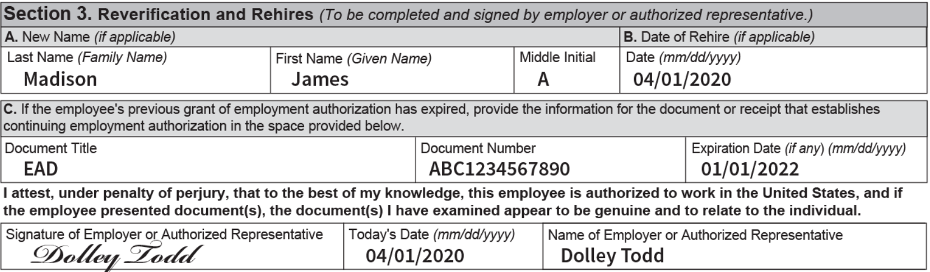
REVERIFICATION
Reverification using Section 3 on the original Form I-9:
  If no name change, simply fill out Block C after examining the documents provided by the employee and sign.
  If there is a name change, appropriately complete Block A before proceeding to Block C.

Slide 18

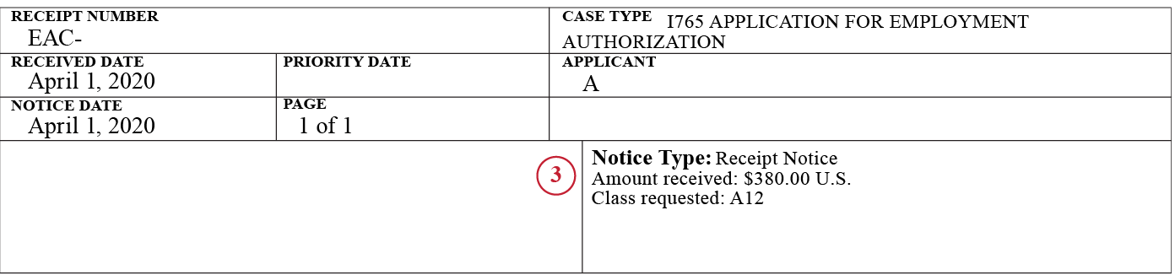
EAD EXTENDED BY TIMELY FILING OF THE RENEWAL APPLICATION
Form I-797C must show a filing date that precedes the EAD expiration date;
Eligibility code on the EAD must match that on the Form I-797C; and
It is one of the following eligibility codes: A03, A05, A07, A08, A10, A12, C08, C09, C10, C16, C19, C20, C22, C24.
Notes:
8 C.F.R. 274a.13(d)(1)

Slide 19
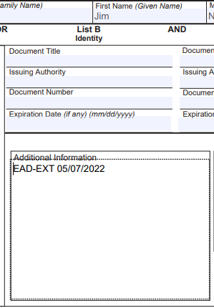
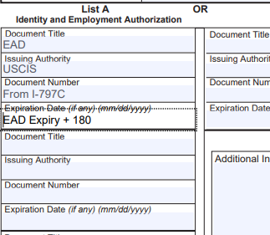
EAD EXTENDED BY TIMELY FILING OF THE RENEWAL APPLICATION
For new employees:
  Select “alien authorized to work” and add 180 days to the expiration date on the EAD for “work authorized until date;”
  Add “EAD EXT” in the Additional Information field
For existing employees:
  Enter “EAD EXT [expiration date]” in the additional information field.
  Calculate expiration date by adding 180 days to the EAD expiration date.

Slide 20
SPECIAL RULES FOR H-4, E, AND L DEPENDENT SPOUSES
On November 12, 2021, USCIS announced that H-4, E, and L dependent spouses now qualify for EAD auto-extensions.
Employee must present:
  Expired EAD with category code A17, A18, or C26;
  Form I-797C showing timely filed renewal of the EAD (with matching category code); and
  An unexpired Form I-94.
Extensions lasts until the earliest of:
  Expiration of Form I-94;
  180 days from the EAD expiration date; or
  The renewal application is adjudicated.
Notes:
20211112-EmploymentAuthorization.pdf (uscis.gov)
Not yet codified in 8 C.F.R.

Slide 21
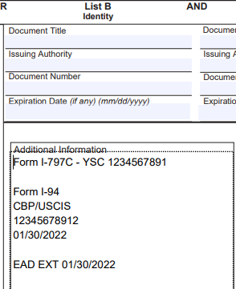
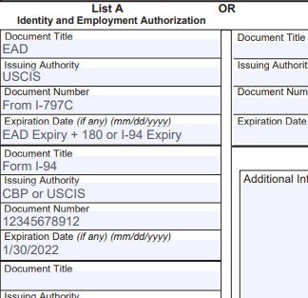
SPECIAL RULES FOR H-4, E, AND L DEPENDENT SPOUSES
For new employees:
  Select “alien authorized to work” and enter the expiration date as calculated on the prior slide;
For existing employees:
Notes:
For new employees:
Select “alien authorized to work” and enter the expiration date as calculated on the prior slide;
Enter “EAD” in the Document Title field;
Enter the Form I-797C receipt number in the Document Number field;
Enter the expiration date (same as the “work authorized until” date); and
Enter the Form I-94 information in the second document field.
For EE
Add the Form I-797C receipt number, Form I-94 document information, and new expiration date in the additional information field using the annotation “EAD EXT [date of expiration].”

Slide 22
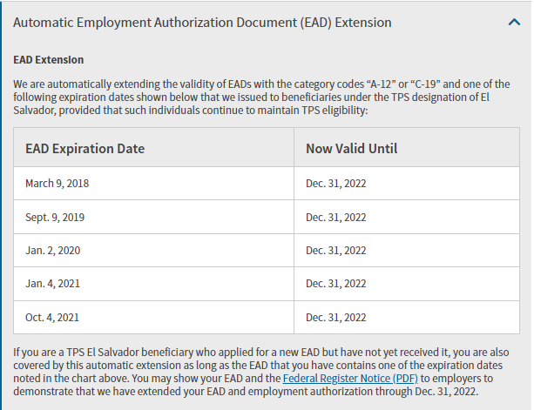
EAD EXTENDED BY FEDERAL REGISTER NOTICE
Applies to TPS beneficiaries
Match Category Code (will be A12 or C19) and expiration date on EAD with the relevant TPS extension notice published in the Federal Register.
Temporary Protected Status | USCIS
Notes:
8 C.F.R. 274a.13(d)(1)(i)

Slide 23
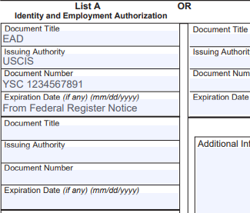
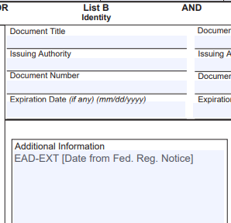
EAD EXTENDED BY FEDERAL REGISTER NOTICE
For new employees:
For existing employees:
Notes:
For new employees:
Select “an alien authorized to work until;” and enter the date provided in the Federal Register notice as the expiration date.
Enter EAD in the Document Title field;
Enter the document number from the expired EAD in the Document Number field;
Enter the automatic extension date listed in the Federal Register as the expiration date
For existing employees:
Update the additional information field of Section 2 with “EAD EXT [expiration date].”

Slide 24

PORTING H-1B EMPLOYEES
H-1B employees have the ability to change employers.
An H-1B employee is authorized to begin employment with a new employer as soon as the Form I-129, Petition for a Nonimmigrant Worker is filed.
An employee completes the Form I-9 as they normally would, except that they must produce the date that the Form I-129 was filed and USCIS suggests employers retain proof of filing with the Form I-9.
The employer or authorized agent completes Section 2 of Form I-9 as they normally would, except that they include the notation “AC-21 [date of Form I-129 filing]” in the additional information field.
Notes:
INA 214(n)

Slide 25
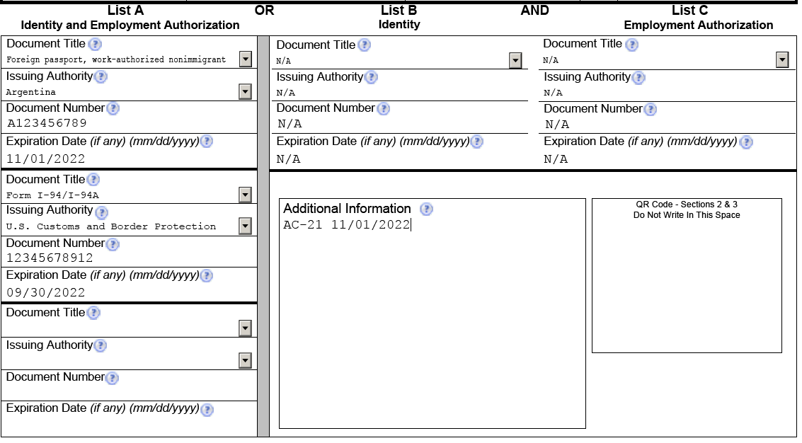
DOCUMENTING H-1B PORTING EMPLOYEES

Slide 26
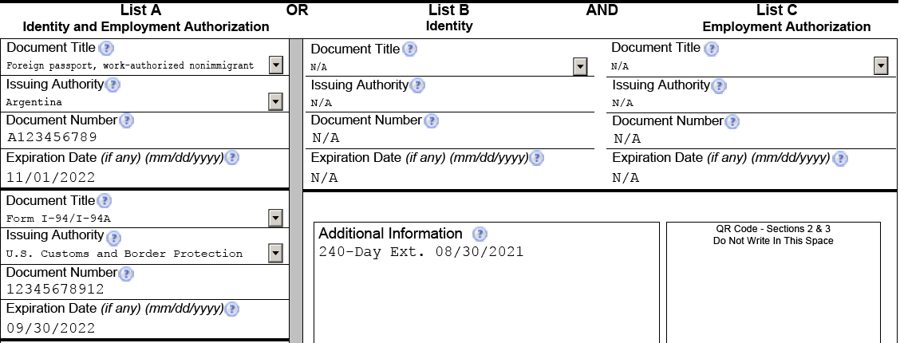
H-1B EXTENSIONS
If the employee is continuing employment with the same employer, they may be eligible for a 240 day extension while their renewal is pending.
Notes:
8 C.F.R. 274a.12(b)(20)
If the Form I-129 is pending when the employee’s work authorization expires, simply add “240-Day Ext. [date of Form I-129 filing]” to the additional information field of Section 2.

Slide 27
H-2A EXTENSIONS
If continuing employment with the new employer, the employee is eligible for a 240 day extension if the Form I-129 is pending and a new labor certification is received.
Notes:
Enter “240-Day Ext. [date of Form I-129 filing]” in the additional information field.

Slide 28
F-1 STEM OPT EXTENSION
STEM degree holders may be eligible for a 24-month extension of their Optional Practical Training if certain conditions are met. Such employees may be eligible for a 180-day extension of their expired EAD.
Must reverify the employee at the end of the 180-day extension period.
The Form I-20 must be complete – including employment status, type, start and end dates, and employer information. Form I-20 must be reviewed.
Must be in good standing with E-Verify prior to the employee onboarding.
Additional immigration-law requirements that should be discussed with immigration counsel prior to beginning the process of hiring.
Notes:
8 C.F.R. 274a.12(b)(6)(v);
8 C.F.R. 214.2(f)(11)(i)(c)

Slide 29
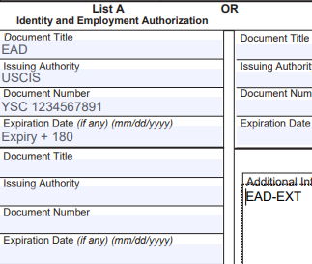
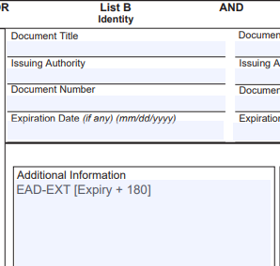
DOCUMENTING F-1 STEP OPT EXTENSION
For new employees:
For existing employees:
Notes:
For new employees:
Examine the unexpired EAD or an expired EAD with Form I-20 and timely filed Form I-765 (Application for Employment Authorization)
Enter EAD in the Document Title field;
Enter the EAD number in the Document Number field;
Calculate 180 days from the EAD expiration date and place it in the Expiration Date field; and
Enter “EAD EXT” in the additional information field.
For existing employees:
Review the Form I-20 recommending STEM extension; and
Enter “EAD EXT [new expiration date]” in the Additional information field.

Slide 30

CAP-GAP EXTENSIONS
Cap-Gap refers to the period between the time an F-1 student’s status would ordinarily end and their H-1B status commences.
  Typically the spring/summer and always October 1
If currently participating in post-completion OPT, the filing of the Form I-129 results in an extension of stay and work authorization.
Requirements:
  Currently participating in post-completion OPT;
  Timely file a petition to change the student’s status to H-1B; and
  Employment start date is October 1 of the year you filed the H-1B petition.
Notes:
8 C.F.R. 274a.12(b)(6)(iv)

Slide 31
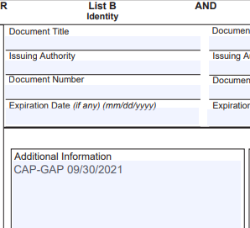
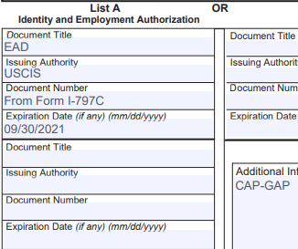
DOCUMENTING THE CAP-GAP EXTENSION
For new employees:
  Select “alien authorized to work until” and enter September 30 of the year the petition was filed as the expiration date
For existing employees:
Notes:
For new employees:
Select “alien authorized to work until” and enter September 30 of the year the petition was filed as the expiration date;
Enter EAD as the Document Title;
Enter the receipt number from the Form I-797C in the Document Number field;
Enter September 30 and the year filed as the Expiration Date; and
Enter CAP-GAP in the Additional Information field.
For existing Employees:
Once the Form I-797C is received, add the “CAP-GAP [expiration date] notation in the Additional Information field.

Slide 32
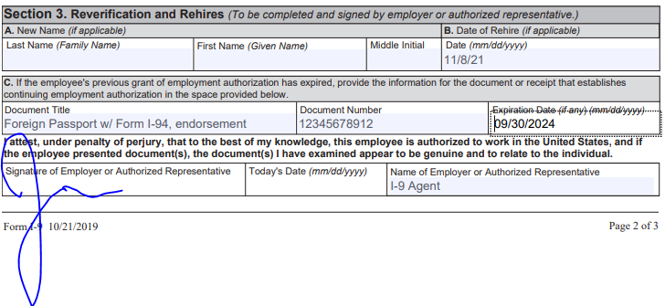
REVERIFYING THE CAP-GAP EMPLOYEE
You must reverify the employment authorization by September 30.
Most times, the employee will produce the Form I-797 with the attached Form I-94 and Foreign Passport.
Enter the Form I-94 information – Document Title; Number; and Expiration Date in Section 3 of Form I-9.
09/26/2021

Slide 33

ACCIDENTS HAPPEN: CORRECTING FORM I-9
According to USCIS, 76% of Forms I-9 are defective or have some sort of error.
Common errors:
  Not timely completing the Form;
  Examining incorrect documents (two list B or C documents);
  Transcription errors;
  Lack of signatures.

Slide 34

ACCIDENTS HAPPEN: CORRECTING FORM I-9
What are some causes of Form I-9 errors?
  Lack of training;
  Lack of infrastructure;
  Lack of diligence;
  Uncooperative employees.

Slide 35
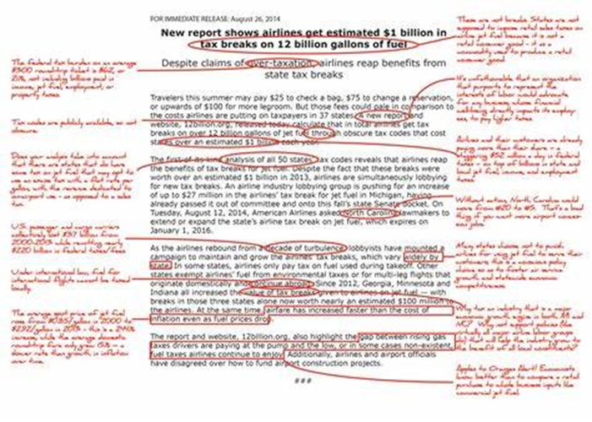
ACCIDENTS HAPPEN: CORRECTING SECTION 1
Correcting Section 1 of Form I-9
  Employee must make the correction by:
    Drawing a line through the incorrect information;
    Entering the correct or omitted information; and
    Initialing and dating the correction or omitted information.
An employee can use a preparer/translator, but the preparer/translator should also initial and date the correction and (if the employee did not previously use a preparer/translator, the preparer/translator must fill out the appropriate boxes in Section 1).

Slide 36
ACCIDENTS HAPPEN: CORRECTING SECTION 2
Only the employer may correct errors in Sections 2 or 3 of Form I-9.
Same three-step process as correcting Section 1.
If there are multiple corrections to be made, the employer may redo the defective Sections on a new Form I-9, attaching an explanatory memorandum explaining the reason a new Form I-9 was completed.
If using a new Form I-9, ensure it is the current version.

Slide 37
ACCIDENTS HAPPEN: GENERAL TIPS
Never conceal any errors or omissions by erasing text or using correction fluid.
Never backdate a Form I-9.
If the wrong version of the Form I-9 was used, print and sign a current version and staple it to the defective Form I-9 and attach an explanatory memorandum.
If you find that incorrect documentation was used on a prior Form I-9, you must complete a new Form I-9, asking the employee to present acceptable documentation.
If upon review, you conclude that a document does not appear to be genuine or relate to the person who presented it, you should address this with the employee and provide the employee with an opportunity to present different documents.

Slide 38
STAFFING FIRMS
Staffing firms are required to either complete Form I-9 themselves or delegate it to their client (the ultimate employer).
  If delegated to the ultimate employer, employer must furnish the staffing agency with a photocopy of the completed Form I-9.
Failure to understand who is to complete the Form I-9 can lead to costly fines and/or worksite enforcement actions which result in the workforce being detained by ICE.

Slide 39
HOW CAN TRUESCREEN HELP YOU?
Digitizing and indexing of historical Forms I-9;
Auditing and remediation services;
Remote completion of Section 2 of Form I-9;
I-9 Management tool that allows a user to monitor the status of Form I-9
  Completion status, hire date, etc. – completely customizable.
  Customizable reverification alerts.

Slide 40
QUESTIONS?
ALEX ERLAM | JOHN MAZZEO
aerlam@truescreen.com jmazzeo@truescreen.com

