Slide 1
Navigating the Treacherous Waters of Form I-9
Fall 2021

Slide 2
INTRODUCTIONS
N. Alexander Erlam, General Counsel
Alex Erlam is Truescreen’s general counsel and employment law specialist. Alex has over 25 years of experience in all areas of employment law, and has developed expertise in background screening law, including the FCRA, the Gramm-Leach-Bliley Act, and the Drivers Protection Act, discrimination law, and immigration law, as well as general human resources expertise. Alex recently served on the Association of Corporate Counsel Board of Directors and is a past president of its Greater Philadelphia chapter. In his role at Truescreen, Alex directs the company’s legal affairs and is responsible for maintaining compliance with all applicable laws and regulations. He serves as our expert resource to clients on legal and regulatory developments and case law. Alex has a law degree from the Temple University James E. Beasley School of Law and a bachelor’s degree in political science/pre-law from Villanova University.
John W. Mazzeo, Associate General Counsel – Director of I-9 and E-Verify Compliance
John Mazzeo is Truescreen’s new Associate General Counsel and Director of I-9 and E-Verify compliance. Previously, John served as an Assistant Chief Counsel with Immigration and Customs Enforcement, a component of the Department of Homeland Security where he served as the legal counsel for all worksite enforcement and Form I-9 investigations and sanctions in Pennsylvania, Delaware, and West Virginia. During his tenure with DHS-ICE, John conducted regular meetings with Homeland Security Investigations Auditors and Special Agents concerning changes in the law and points of concern. In his role at Truescreen, John focuses on supporting our I-9 and E-Verify operations division regarding compliance and best practices. John is available to all of our clients as a subject matter expert on issues involving I-9 and E-Verify. John holds a Juris Doctor from the Drexel University Thomas R. Kline School of Law, and an undergraduate degree from Ursinus College. Like Alex, John is also a member of the Association of Corporate Counsel.

Slide 3
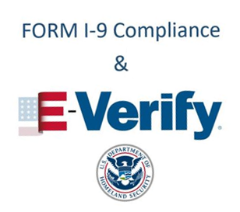
AGENDA
Session I – Overview of Form I-9
Session II – Advanced Form I-9 Issues
Session III – Handling the Form I-9 Audit
Session IV – Overview of the E-Verify Program
This webinar is designed solely for informational purposes, and should not be inferred or understood as legal advice or binding case law, nor shared with any third parties. Persons in need of legal assistance should seek the advice of competent legal counsel.

Slide 4
TODAY’S AGENDA
Overview of Form I-9
Dissecting the Form I-9
COVID-19 Flexibilities
Storage and Retention Requirements
Notable Issues
Audits and Enforcement
Case Studies
Services Offered

Slide 5
OVERVIEW OF THE FORM I-9
The Immigrant Reform and Control Act (IRCA) prohibits employers from hiring individuals without verifying their identity and work authorization.
Form I-9, Employment Eligibility Verification Form, is required for each employee hired after November 6, 1986.
The employer or his/her authorized representative must supply the employee with the instructions and List of Acceptable Documents in either print or electronic form.
Form I-9 cannot be used for prescreening.

Slide 6
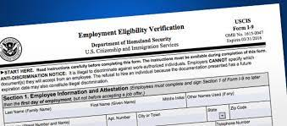
THREE VERSIONS OF FORM I-9
Paper version.
“Smart” version.
Electronic version.
The Form I-9 is available in English and Spanish
The English version must be used everywhere except in Puerto Rico, but the Spanish version may be used as a translation guide.
Must always use the current version of the Form I-9.
Expiration date is located in the top right corner, issue date is in the lower left corner.

Slide 8
FORM I-9 HAS THREE SECTIONS
Section 1 must be completed and signed by the employee at some point no earlier than the acceptance of the job offer and no later than the first day of employment.
Section 2 must be completed by the employer or his/her authorized representative no later than the third business day of employment.
Includes physical, in-person document examination and certification.
Section 3 is completed by the employer in cases of:
Reverification when an employee has temporary work authorization;
Name changes; and
Rehires under specific circumstances.

Slide 9
COVID-19 FLEXIBILITIES
Current Rule: Any employee hired on or after April 1, 2021 who is working exclusively in a remote setting due to COVID-19 related precautions is temporarily exempt from the in-person document inspection requirements associated with the Form I-9 until they undertake non-remote employment on a regular, consistent, or predictable basis, or until December 31, 2021, whichever is earlier.
Document inspection can be completed through fax, email, or weblink.
USCIS’ most recent guidance states that the in-person inspection requirement applies only to those employees who physically report to work at a company location on any regular, consistent, or predictable basis.
Prior guidance stated that if any employees were physically reporting then no employees qualified for the flexibilities.

Slide 10
COVID-19 FLEXIBILITIES
The “flexibilities” did not extend or alter the deadlines for completing Form I-9.
These “flexibilities” required employers to conduct an in-person inspection of these documents either within 3 days of the individual returning to the office on a predictable basis, or the termination of the flexibilities.
Employers should note the date of the COVID-19 “remote” inspection and the date of the subsequent in-person inspection in the Additional Information field of Section 2.

Slide 11
STORAGE AND RETENTION REQUIREMENTS
The employer is required to retain the Form I-9 and any copies of supporting documents (if made) for either:
Three years from the date of hire; or
One year from the date of termination, whichever is later.
Forms I-9 may be stored electronically even if they were completed by hand, but electronic storage systems require safeguards be implemented.
Best practice not to keep Forms I-9 in the employee’s personnel file.

Slide 12
NOTABLE ISSUES
No fields may be left empty. All empty fields should contain “N/A.”
If an employee did not use a preparer or translator, he/she must check the box denoting such.
The “Additional Information” field can be used by the employer to add information such as E-Verify case numbers, information regarding extensions, employee termination dates, etc.

Slide 13
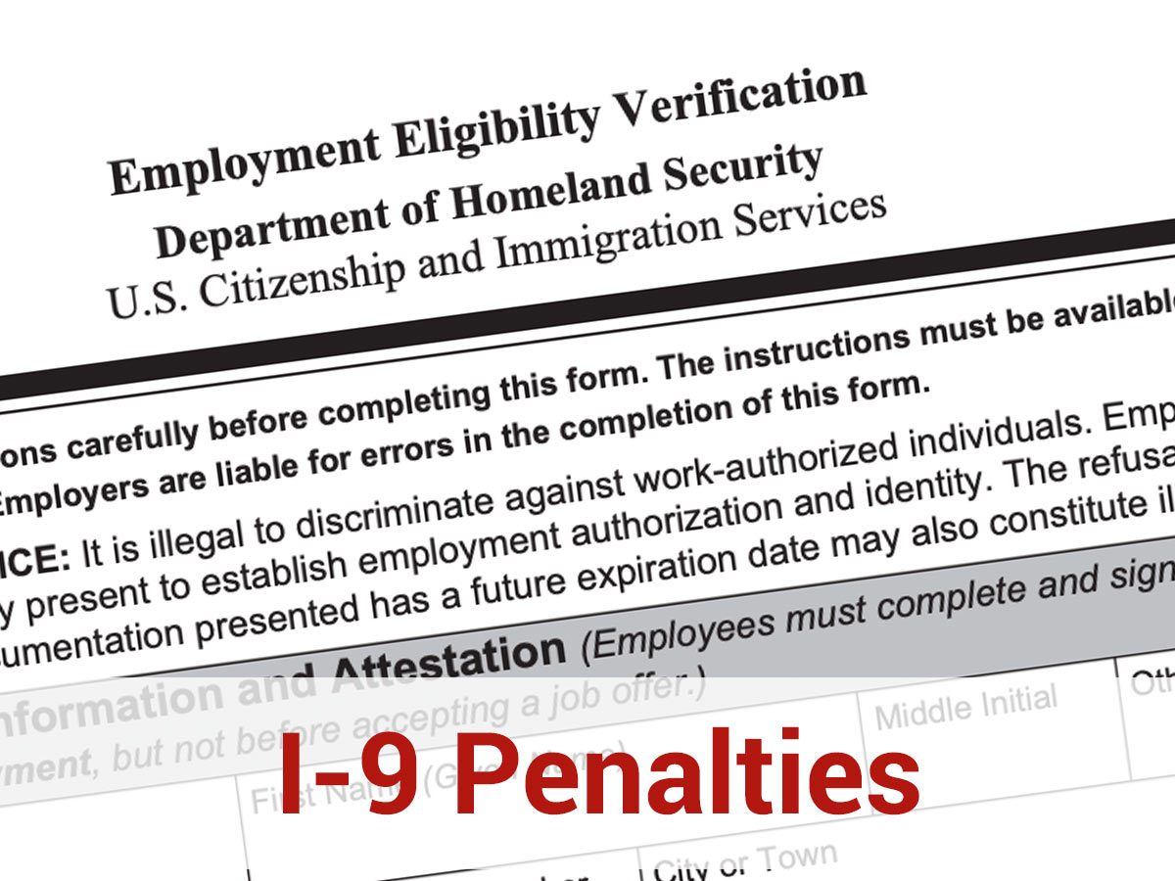
AUDITS AND ENFORCEMENT
According to USCIS, 76% of paper Forms I-9 contain an error that could result in a fine.
Violations divided into “substantive paperwork violations” and “technical or procedural violations.”
Substantive violations can result in a fine without notice.
Technical or procedural violations are subject to a notice and 10-day curing period before they can result in a fine.
Audit typically initiated by the issuance of a “Notice of Inspection” by Immigration and Customs Enforcement.

Slide 14
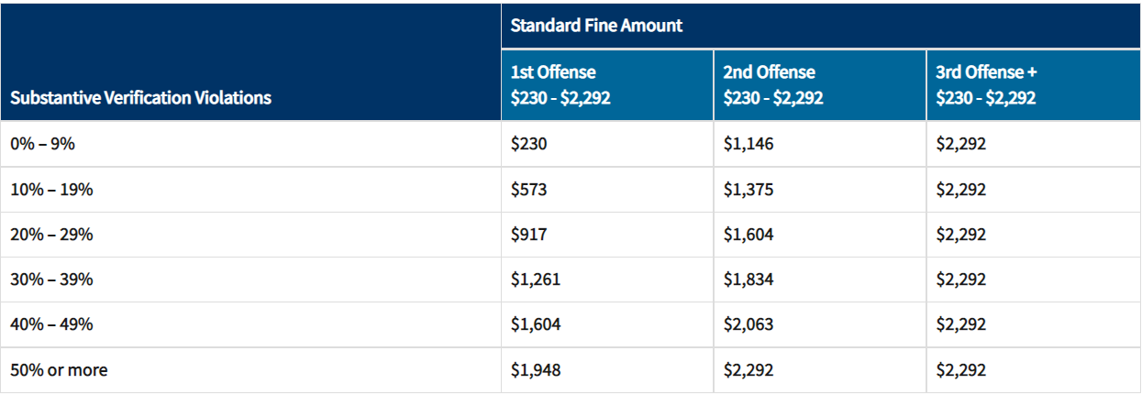
AUDITS AND ENFORCEMENT
Base fine amounts vary:

Slide 15
AUDITS AND ENFORCEMENT
The base fine can be mitigated or aggravated by five percent based on:
Size of Business;
History of Violations;
Good faith;
Seriousness of violations; and
Presence of unauthorized workers.
Fines can also be mitigated based on equity arguments, i.e. ability to pay.

Slide 16
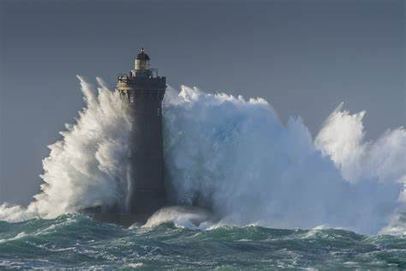
U.S. v. Imacuclean Cleaning Services, LLC.
ICE Issued 3 Count Notice of Intent to Fine totaling $1,238,509.30.
Count I – Failure to Prepare or Present 224 Forms I-9
Count II – Failure to Timely Prepare 102 Forms I-9
Count III – Failure to Ensure Proper Completion of Section 1 and/or Properly Complete Section 2 or 3 for 337 Forms I-9
Violations:
No employee attestation;
No employer attestation;
No documents recorded;
No check-box in section 1;
Missing a page.
10 violations not sustained
On Motion for Summary Decision, the Administrative Law Judge found Imacuclean liable for all but 10 violations and ordered them to pay $1,161,143.20 in penalties; $1,808.63 per Form I-9.
Notes:
**Note: These are cases where the company actually requested a hearing and no settlement was reached prior to motions practice.
U.S. v. Imacuclean Cleaning Services, LLC., 13 OCAHO no. 1327 (2019). NOI served 3/20/17; 3/23/17 R produced 578 Forms I-9.

Slide 17
U.S. v. Integrity Concrete, Inc. & American Concrete, Inc.
ICE Issued Integrity Concrete a 3 Count Notice of Intent to Fine Totaling $24,684.00.
Count I – Failure to Prepare or Present 5 Forms I-9
Count II – Failure to Ensure Proper Completion of Section 1 for 3 Forms I-9
Count III – Failure to Properly Complete Section 2 and/or 3 for 16 Forms I-9
ICE Issued American Concrete a 2 Count Notice of Intent to Fine Totaling $5,390.00.
Count I – Failure to Prepare or Present 10 Forms I-9
Count II – Failure to Ensure Proper Completion of Section 1/Properly Complete Sections 2 or 3 for 1 Form I-9
This violation was later moved to Count I.
Notes:
13 OCAHO no. 1307 (2017)
Integrity: NOI 1/7/15; NTPF issued 3/11/15 (4 violations); NOSD issued 3/11/15 (9 employees); 3/17/15: notified ICE that 8 employees listed in NOSD had been terminated, one verified. NIF was $935/violation.
American: NOI: 1/15/15; NTPF (12 violations): 3/11/15; NOSD (5 employees): 3/11/15. Change to Notice of Inspection Results stating 1 NOSD authorized: 3/13/15; also on 3/13/15 ICE notified that 3 of 4 remaining NOSD employees terminated; 3/17/15 last NOSD employee terminated.

Slide 18
U.S. v. Integrity Concrete, Inc. & American Concrete, Inc.
On Motion for Summary Judgement, Respondent admitted liability for all violations
ALJ reduced the fine to $500 per violation for the Failures to Prepare and $400 per violation for the Failures to Ensure Proper Completion of Section 1 and/or Properly Complete Sections 2 or 3:
Integrity ordered to pay $11,325 in penalties; $481.87 per Form I-9.
American ordered to pay $5,500 in penalties; $500 per Form I-9.

Slide 19
U.S. v. Eriksmoen Cottages, Ltd.
ICE issued a 2 Count Notice of Intent to Fine totaling $35,977.50
Count I - Failure to Prepare/Present for 6 Forms I-9;
Count II – Failure to Ensure Proper Completion of Section 1 and/or Failure to Properly Complete Sections 2 or 3 for 24 Forms I-9
Failure to check box in section 1;
Failure to review, verify, and identify a proper List A or B and C document in Section 2;
Failure to reverify; and
Lack of Alien Number in Section 1.
Administrative Law Judge reduced fine from $1,230 per violation to $1,199.25 per violation.
Fine was issued even though business had COVID-19 related losses.

Slide 20
“Compliance with the law is the expectation, not the exception.”
Notes:
U.S. v. Alpine Staffing, Inc., 12 OCAHO no. 1303, at 18-19 (2017).

Slide 21
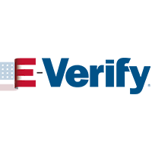
E-VERIFY
Free web-based platform that allows an employer to quickly and easily check the employment authorization status of new hires.
Partnership between the Department of Homeland Security (DHS) and the Social Security Administration (SSA).
Required in some states for all employees.
Required for every employer who is the recipient of certain federal contracts issued after September 8, 2009.
Not to be used for prescreening and does not constitute a safe harbor from I-9 Audits.

Slide 22
SERVICES OFFERED
I-9 Management Tool:
Enables seamless completion and indexing of Form I-9.
Ability to set alerts (for reverification) and for destruction.
Established customer support channels including an on-staff attorney who specializes in Form I-9 compliance.
Remote Verification and Completion of Section 2:
Through our nationwide Fieldprint Remote Service Network, your remote hires can process their Forms I-9 conveniently and efficiently.
Indexing of Historical Forms I-9.
Auditing and Remediation of Historical Forms I-9.
E-Verify Solution.

Slide 23
QUESTIONS?
ALEX ERLAM | JOHN MAZZEO
aerlam@truescreen.com jmazzeo@truescreen.com

